Slide 1
Rent Assistance
Content is correct as of September 2026.
For more information go to servicesaustralia.gov.au/rentassistance

Slide 2

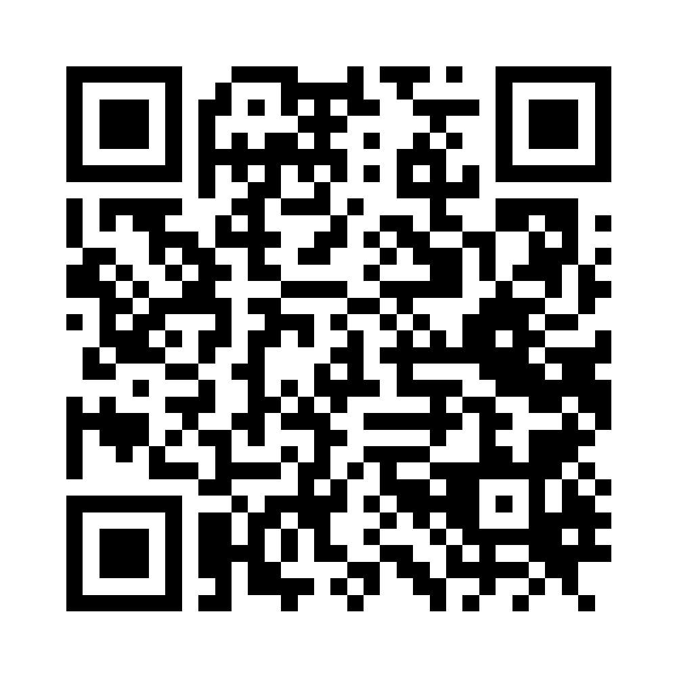

What is Rent Assistance
If you pay eligible rent or accommodation costs, you may be able to get Rent Assistance.
You may need to give us proof of how much you pay.
IMPORTANT!
If you move to
a new house or
your rent amount
changes, let us know within
14 days.
servicesaustralia.gov.au/rentassistance
QC 22206
Notes:
Rent Assistance helps you pay your rent or accommodation costs if you get an eligible payment from us. It is an extra amount, paid with your Centrelink payment.
We check if you can get Rent Assistance when you claim a payment or when you tell us you have moved to a new address or the amount of rent or accommodation costs you pay changes.
We may ask you to provide a copy of your lease agreement, rental contract or proof of accommodation costs to verify your rent or accommodation details. Sometimes we may ask you and the landlord or real estate agent to complete and sign a form called a Rent Certificate.
You don’t need to verify your rent if you transfer payments or live in some types of accommodation. For example, a boarding house, hotel, hostel, or lodging house.
If your rent changes, stops or you move to a new address you must tell us within 14 days. You can tell us in person, over the phone or online using your myGov account.
This is to make sure you get the right amount of payment and helps you to avoid being overpaid.
Resource:
Rent Assistance factsheet, available in 21 languages - Arabic, Assyrian, Burmese, Chaldean, Chinese (Simplified), Dari, Hazaragi, Karen, Khmer, Korean, Kurdish (Kurmanji), Nepali, Persian (Farsi), Russian, Somali, Spanish, Swahili, Tagalog, Thai, Turkish and Vietnamese - servicesaustralia.gov.au/rent-assistance-translation or QC 45141

Slide 3


Who can get it
You can get Rent Assistance if you get an eligible payment and the amount of rent or accommodation costs you pay is over a certain amount.
You don't need to apply for Rent Assistance.
If eligible, we pay it with your regular payment.
Notes:
You need to meet some rules to get Rent Assistance.
If you meet the rules we pay you automatically, you don’t need to apply.
To get Rent Assistance you must:
get an eligible payment or get more than the base rate of Family Tax Benefit Part A
live in an eligible accommodation type
pay more than the minimum amount of rent or accommodation costs
meet special rules if you’re 25 or younger.

Slide 4
Eligible payments
To get Rent Assistance, you must get one of these payments:
  ABSTUDY Living Allowance
  Age Pension
  Austudy
  Carer Payment
  Disability Support Pension
  Family Tax Benefit - Part A at more than the base rate
  Farm Household Allowance
  JobSeeker Payment
  Parenting Payment
  Special Benefit
  Youth Allowance.
There are special rules if you get:
  ABSTUDY Living Allowance if you’re 24 or younger
  Disability Support Pension if you’re 20 or younger
  JobSeeker Payment if you’re 25 or younger
  Youth Allowance if you’re 24 or younger.
Notes:
To get Rent Assistance you must get an eligible payment.
We check if you can get Rent Assistance when you claim a payment or if you tell us about a change when you get an eligible payment.
Special rules apply if you get:
ABSTUDY Living Allowance if you’re 24 or younger
Disability Support Pension if you’re 20 or younger
JobSeeker Payment if you’re 25 or younger
Youth Allowance if you’re 24 or younger.
Find the special rules for each of these payments on our website.

Slide 5
Eligible rent and accommodation types
Eligible accommodation types include:
board and lodging
community and disability housing
defence housing
private housing
retirement and lifestyle villages
travelling, site and mooring fees
housing if you’re 25 or younger.
Eligible accommodation costs include:
rent
fees in a retirement village
fees in an over 55’s village or lifestyle park
lodging
board and lodging
site or mooring fees.
Notes:
To be eligible for Rent Assistance, you must be paying one of the following eligible accommodation costs:
rent
fees in a retirement village
fees in an over 55’s village or lifestyle park
lodging
board and lodging
site or mooring fees.
Eligible accommodation types include:
board and lodging
community and disability housing
defence housing
private housing
retirement and lifestyle villages
travelling, site and mooring fees
housing if you’re 25 or younger living with or without your parents or guardians.
If you get Rent Assistance, you must tell us about changes to your rent or accommodation. For example, if:
the amount of rent or accommodation costs you pay changes
you moved to or are planning to move to a new address
you start or stop sharing accommodation with someone else
you start or stop living with a partner.

Slide 6
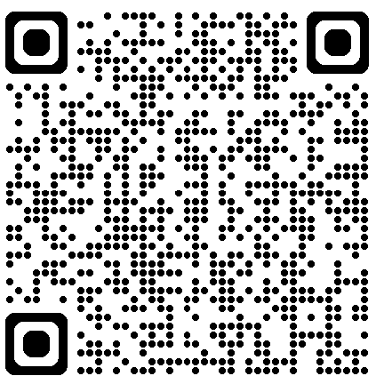
How much you can get
The amount of Rent Assistance you can get depends on:
  how much rent or accommodation costs you pay
  the type of payment you get from us and if you have children
  if you share the cost of rent or accommodation costs with other people
  if you are living away from your partner for some reasons.
servicesaustralia.gov.au/how-much-rent-assistance-you-can-get
QC 51757
Notes:
You must pay more than the minimum amount of rent or accommodation costs to get Rent Assistance.
We work out the amount of Rent Assistance you can get up to the maximum amount using the amount of rent or accommodation costs you pay.
The amount of Rent Assistance you get may also change if any of these things happen:
the rent or accommodation costs you pay increases or decreases
you move house
your income increases or decreases
payments you get from us increase or decrease
your family circumstances change, for example you separate from your partner, or the number of children in your care changes.
We review Rent Assistance rates on 20 March and 20 September each year. This is in line with the Consumer Price Index.
Note to facilitator: use the link to the webpage on the slide for more specific rates for Rent Assistance that we pay with an income support payment, ABSTUDY or Family Tax Benefit.

Slide 7
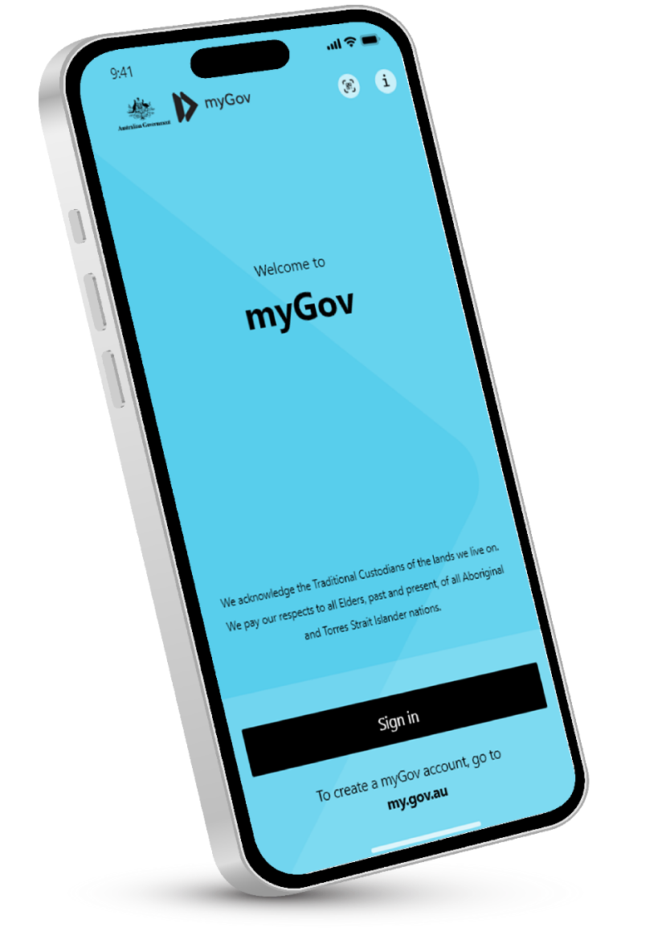
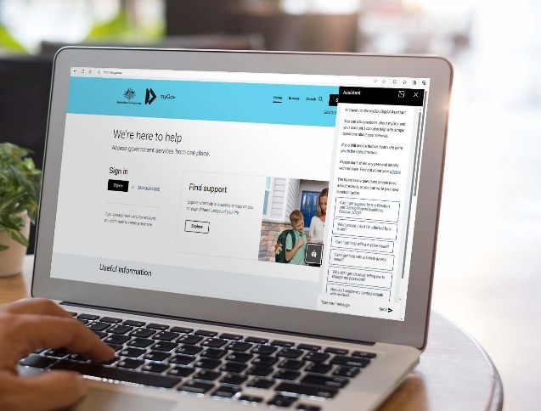
Update your accommodation details online
Sign in to myGov and select Centrelink.
2. Select MENU from their homepage.
3. Select My details.
4. Select Personal details then Update accommodation details.
Notes:
To get the right amount of Rent Assistance you must keep your details up to date, including the amount of rent you pay, if you move address or if you stop paying rent.
You must update your address and accommodation details within 14 days of any change.
If you need more help online, you can use our Update address and accommodation details help guide on our website. You can find it by typing QC 37491 into the search.
If you can’t tell us online you can:
call us on your regular payment line
visit a service centre.
If you only need to update your rent amount, you can get your housing provider to update it for you if they use the Electronic Verification of Rent (EVoR) online service.
Let us know if you need an interpreter and we will arrange one for free.

Slide 8
Temporary changes
You may still get Rent Assistance if you are away from home for a short time because you are:
  getting medical treatment or need short-term care
  taking care of someone
  studying to improve your chance of getting work
  staying somewhere else due to an emergency, crisis or family and domestic violence.
Notes:
Tell us within 14 days if you plan to live away from your home address for a short period of time.
Depending on the reason, you may still get Rent Assistance, and we may ask you to give us more information.
We’ll check if you can still get Rent Assistance at the temporary address if your move is for any of these reasons. You:
go into respite care
live in refuge type accommodation such as refuge, crisis or emergency accommodation for less than 3 months
plan to return to your home
sell the home you live in and will use the money to build, renovate or buy another
live in another person's home as you’re affected by family and domestic violence
live away from your usual address so your child can go to school, and you don’t get any other payment for the same purpose.

Slide 9
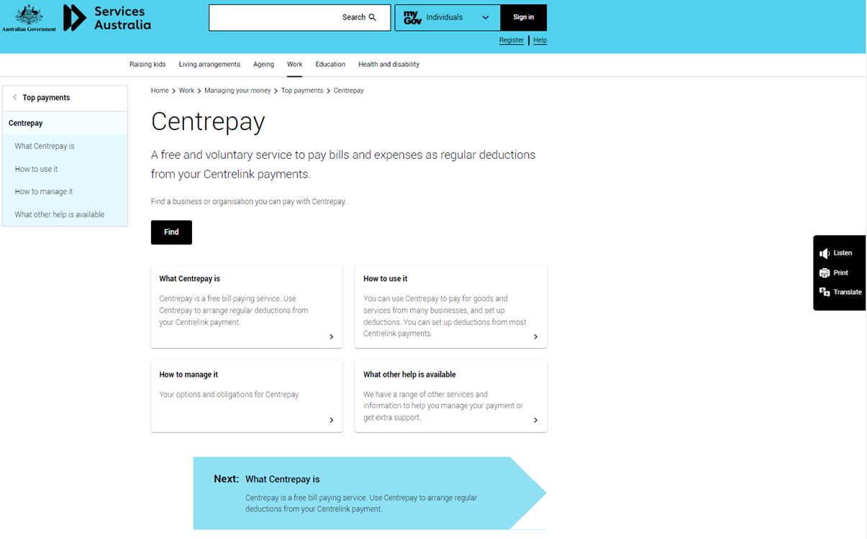
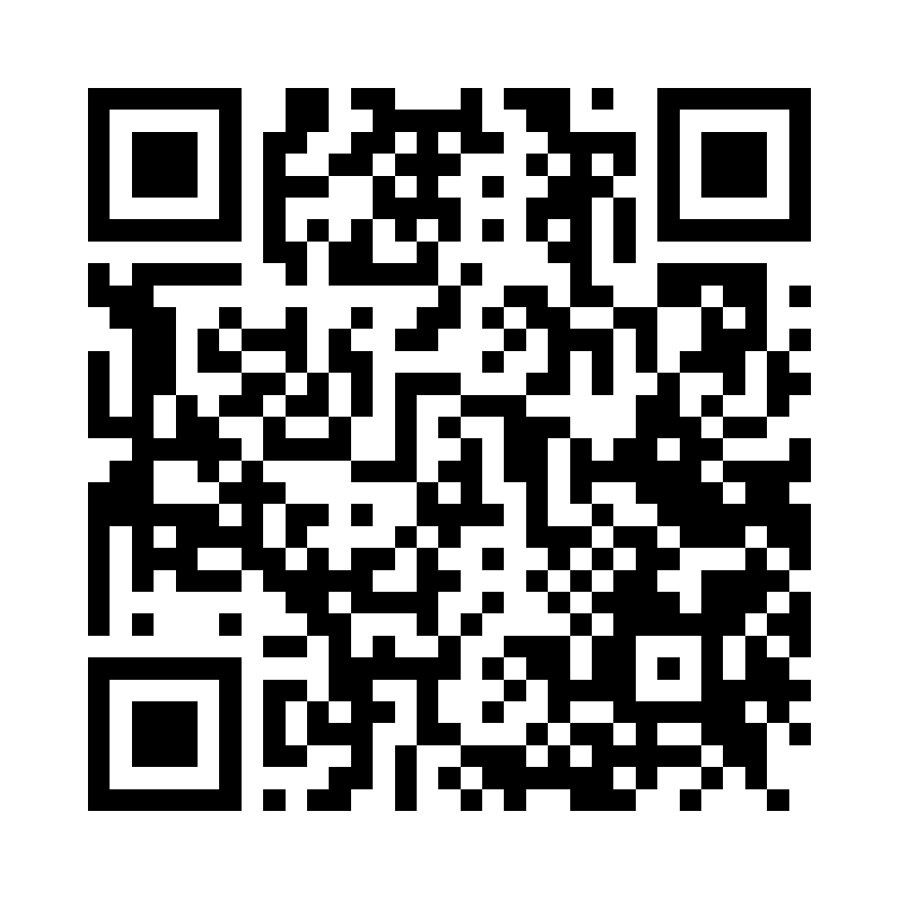

.
Using Centrepay to pay rent
You can set up a Centrepay deduction to pay your rent or accommodation costs.
We’ll take the money from your Centrelink payment and send it straight to your housing or accommodation provider.
You can stop or change a
Centrepay deduction at anytime.
servicesaustralia.gov.au/centrepay
QC 22366
Notes:
Centrepay is a free service to help pay some bills like rent or accommodation costs directly from your Centrelink payment.
Your housing organisation or accommodation provider must be registered with us to use Centrepay.
How does it work?
You tell us:
who you want to pay
how much you want to pay them
which Centrelink payment you want the money to come from
when to start and stop the deduction.
If you pay your rent using Centrepay you must tell us about changes. We won’t change the amount or stop the deduction unless you tell us to stop or change it. You can also change or stop a Centrelink deduction at any time using your myGov online account.
You must update your accommodation details separately to updating your Centrepay deduction.
Resources:
Centrepay audio – available in 20 languages: Arabic, Assyrian, Burmese, Cantonese, Chaldean, Dari, Hazaragi, Khmer, Korean, Kurdish (Kurmanji) Nepali, Persian (Farsi), Russian, Spanish, Swahili, Thai, Turkish, Ukrainian and Vietnamese - servicesaustralia.gov.au/centrepay-audio-translation or search QC 45221

Slide 10
Thank you! If you need more information, go to our website servicesaustralia.gov.au/rentassistance or type QC 2206 into the search.

