Slide 1
An overview of student payments

Slide 2




Youth Allowance
Financial help for students, trainees and Australian Apprentices under 25
Helps with the cost of living and studying
May help with travel between your permanent home and study location
The maximum rate is about $639 per fortnight for those living out of home
Notes:
Youth Allowance is the most common student payment for people aged 18 to 24, though sometimes 16 and 17 year olds can get it.
It’s for full time students, trainees and Australian Apprentices. Normally you need to be studying at TAFE, university or another higher education provider.
This fortnightly payment helps with living costs and some study expenses. It may help you pay for the costs of traveling between your permanent home and study location if you need to live away from home to study.
The maximum rate for Youth Allowance is around $639 per fortnight for students living out of home. This rate is updated several times a year.

Slide 3



ABSTUDY
Payments and support for Aboriginal and Torres Strait Islander students and apprentices
Helps with cost of study materials
Helps with travel for students who need to live away from home
Helps with cost of living and studying
Notes:
ABSTUDY is support for Aboriginal and Torres Strait Islanders who are studying or doing an apprenticeship.
ABSTUDY can help secondary and higher education students with living, study, travel and relocation costs.
There is more information about ABSTUDY and the different payments available on the Services Australia website.

Slide 4

ABSTUDY videos
English
Indigenous language playlists
Yankunytjatjara
Yumplatok
Pitjantjatjara
Warlpiri
Kimberley Kriol
Watch on YouTube ABSTUDY for higher education and training
Notes:
[OPTIONAL SLIDE] There is also a suite of videos on YouTube about ABSTUDY.
This video talks about the ABSTUDY support available for higher education and training.

Slide 5
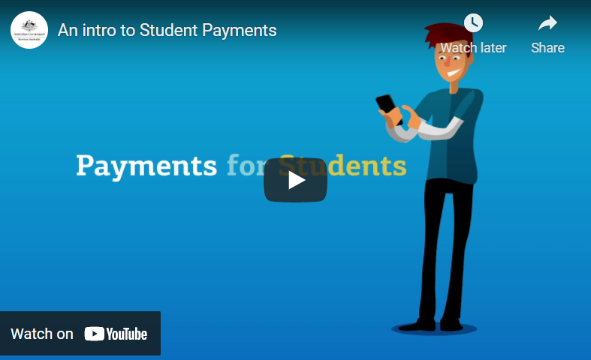
Extra assistance for some students
Tertiary Access Payment – up to $5,000 to help with moving costs from regional and remote areas for uni or TAFE
Rent Assistance – a payment to help with the costs of living out of home
Relocation Scholarship – annual payment if you’ve moved from or to a regional or remote area for tertiary study
Fares Allowance – a payment towards travel costs between your permanent home and place of study
Student Start-up Loan – a voluntary loan of approx. $1,200 twice a year that has to be paid back
Watch on YouTube An intro to Student Payments
Notes:
There are some other payments you might be able to get as a student, depending on your situation.
If you’re moving for study after Year 12 you might be able to get the Tertiary Access Payment. It’s a one off payment that can help pay for moving and study costs.
You may be able to get Rent Assistance if you’re getting another payment from Services Australia and you’re renting or boarding.
The Relocation Scholarship is a once a year payment if you get ABSTUDY or Youth Allowance. To get this, you must need to move to or from a regional or remote area for higher education study.
The Student Start-up Loan is a voluntary loan you can get up to twice a year if you’re an eligible higher education student. You have to be getting Youth Allowance or ABSTUDY Living Allowance. You have to pay back the loan once you start earning a certain amount of income.

Slide 6
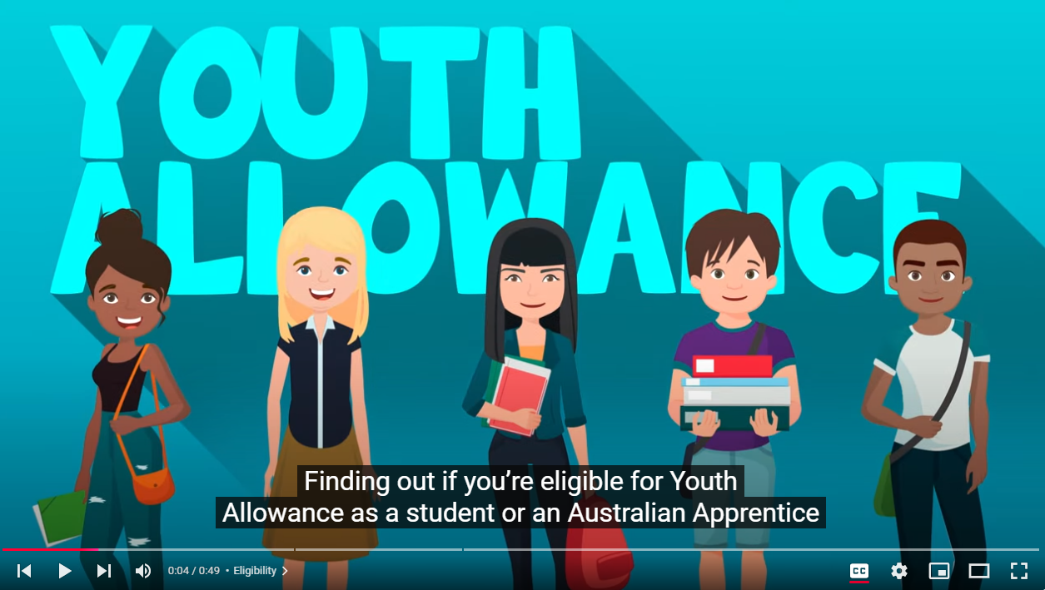
Eligibility for student payments
There are certain things you’ll be assessed on when you apply for a student payment.
These include:
if you’re studying full time in an approved course at an approved provider
your parents’ income
your income.
Watch on YouTube Youth Allowance eligibility explained
Notes:
Eligibility to get a student payment will differ slightly depending on which student payment you claim.
One of the main things taken into account is your parent’s income when you’re under 22. This can affect the rate you get. Services Australia also needs to know your income if you’re working as well as studying.
You usually have to be studying an approved course full time at uni, TAFE or another higher education provider.
The video talks only about Youth Allowance. It’s the most common payment for tertiary students.

Slide 7
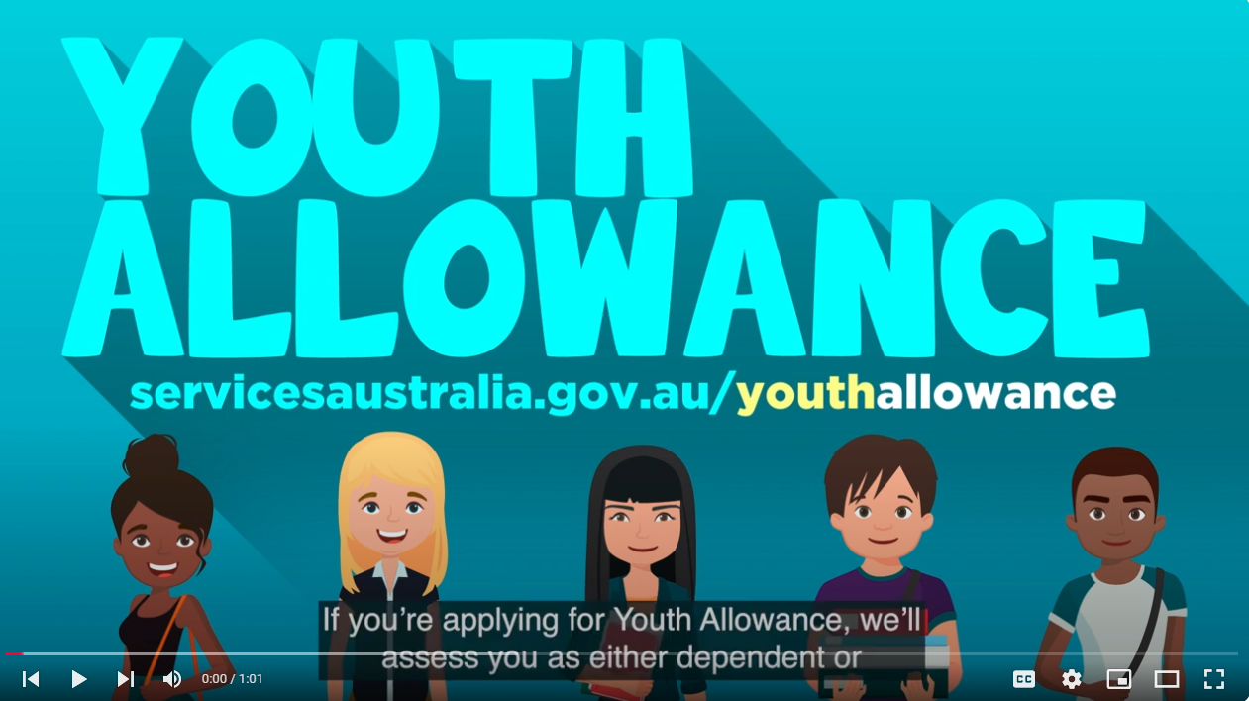
Dependent or independent – how it affect payments
Dependent
Your parents’ income may impact your payment
Includes most students who are 21 or younger
Independent
Your parents’ income won’t impact your payment
Includes people aged 22 or older
Also includes people who are married or have a child
Can include people under 22 years in specific circumstances
Watch on YouTube
Youth Allowance: dependent or independent
Notes:
If you’re getting a student payment, the amount you get will be affected by whether you’re considered dependent or independent.
ABSTUDY and Youth Allowance have different criteria when this is assessed. Make sure you check the Services Australia website for more information.
For most people they will be dependent up until 22. In some circumstances there might be a reason why you could be considered independent before 22.
This includes things like supporting yourself while working, if you have a child or if you’re married.
This video talks about dependence and independence for students claiming Youth Allowance.

Slide 8


Approved courses and course providers
To get a student payment, you must study an approved course with an approved provider
Approved courses
Some Certificate courses
Diplomas
Degrees
Australian Apprenticeships
Vocational Education Training (VET) courses
Approved providers
Universities
TAFE
Registered training organisations (RTOs)
Other higher education providers
Notes:
Your course needs to be approved.
Approved courses of study include:
a TAFE or university course
secondary school course
special school course
school-based apprenticeship
traineeship
pre-vocational or vocational education course
a course preparing you for tertiary study
English as a Second Language course.
You can check if your course is an approved course through the Services Australia website.

Slide 9

Study load
Most students need to be studying full time to get Youth Allowance or ABSTUDY
Full time is 75% or more of your course’s full time study load
You need to let Services Australia know if this changes
Notes:
You’re studying full time if you’re doing 75% or more of your course’s full time study load.
This is worked out using one of the following:
your Equivalent Full Time Study Load (EFTSL)
your credit points
the amount of hours you study.
You’re studying part time if you’re doing less than 75% of your course’s full time study load.
You must tell Services Australia if your study load goes below 75%. This usually means you can’t get a student payment.
If you’re under 22 and studying part time, you might get Youth Allowance as a job seeker. You’ll need to do some other activities as well.
Aboriginal and Torres Strait Islander students enrolled in part time study may get ABSTUDY payments.

Slide 10
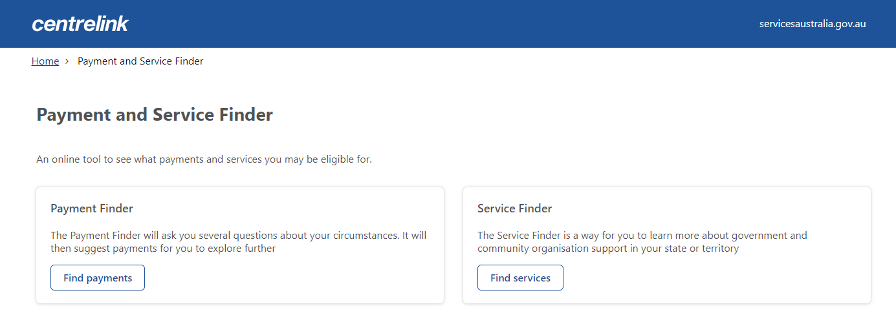
Payment and Service Finder
Find what payment is right for you
Enter some details including your parents’ income
Find out how much your fortnightly payment could be
Notes:
The best way for students to find out if they can get a payment is to use the Payment and Service Finder. There’s a link to it from the main student webpage on the Services Australia website.
It only takes a few minutes to enter in some basic details and you’ll get an idea straight away of whether you’re eligible for a payment. Answer a few more questions, and you can get an estimate of how much you may be paid each fortnight.

Slide 11
When to claim
Australian Taxation Office (ATO)
1. Apply for a tax file number
Online or phone
4. Confirm your identity as per the instructions you get from Services Australia
myGov website
4. Use your Centrelink account through myGov to claim a payment
myGov website
(my.gov.au)
2. Create a myGov account
myGov website
3. Link Centrelink to your myGov account
You can claim up to 13 weeks before your uni or TAFE course starts
Notes:
It’s important to know that you can put in your claim for a student payment in advance of your course start date. You can claim a payment up to 13 weeks before your course starts.
This means if you’re approved for a student payment, you’re more likely to get your payment on time.
Follow the steps to claim a payment online.

Slide 12
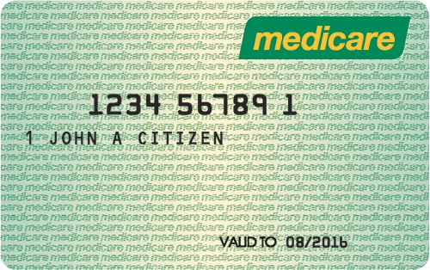
Medicare
Use your Medicare online account through myGov to:
update your bank details
request your own Medicare card
get proof of your vaccinations.
When you turn 14, you’ll need to update your bank details in your Medicare online account to get Medicare benefits.
When you turn 15, you can have your own Medicare card.
Notes:
There are certain changes that will happen depending on your age.
When you turn 14, you’ll need to update your bank details in your Medicare online account to get Medicare benefits. You should do this even if you choose to stay on your parents’ Medicare card.
If you pay for a health service using your own bank account, you’ll get the Medicare benefit in your bank account. If your parent pays for your health service, they’ll get the Medicare benefit in their bank account.
If you don’t have a Medicare online account, you can set up one.
Go to https://my.gov.au/
If you’re 14 or older, your parents won’t be able to access your immunisation history. You can request your immunisation history statement, either with your:
Medicare online account through myGov
Express Plus Medicare mobile app.
If you’re not eligible for Medicare, you can still get proof of your immunisation history using the Individual Healthcare Identifiers service through myGov.

Slide 13



More information
servicesaustralia.gov.au/leavingschool provides help with:
deciding what to do after school
preparing for your next steps
continuing study
starting an apprenticeship or traineeship
getting a job
transitioning from state care
You can also ask Services Australia questions about student payments on social media
Notes:
The Leaving secondary school webpage is the first place students should look if they’re thinking of further study and think they may need some financial support. There are also links to other useful government webpages, including how to get a tax file number and free careers advice.
servicesaustralia.gov.au/leavingschool

Slide 14
servicesaustralia.gov.au/studentpayments

