Slide 1
ABSTUDY –
Preparing for high school
ABSTUDY helps students stay connected to family, community and culture.

Slide 2

What is ABSTUDY?
Support for Aboriginal and Torres Strait Islander Australians to help with studying and training
ABSTUDY can be paid as your child moves through their schooling years
Help with the costs of travel, school fees, living costs, boarding fees, books and stationery.
Watch on YouTube
https://www.youtube.com/watch?v=kkOESQiHegs
Notes:
[OPTION TO PLAY VIDEO OR READ FROM NOTES] – This video talks about the ABSTUDY support available for higher education and training.
ABSTUDY can help your child while they study or train.
ABSTUDY can help cover costs as your child moves through their schooling years, including higher education and apprenticeships.
It can help pay for school fees, living costs, boarding fees, books and stationery.
ABSTUDY also covers travel costs if your child has to leave home to go to high school. This includes travelling for open days before they enrol, coming home for holidays or other reasons.
You can find out more about what help is available for your child through ABSTUDY on the Services Australia website: servicesaustralia.gov.au/abstudy.

Slide 3


ABSTUDY if your child lives at home
Once a year, and term payments, to help with school fees, uniforms, textbooks, stationery and more…
Higher rate of ABSTUDY School Fees Allowance if they are unable to attend a local government school
Other payments available once your child turns 16.
Watch on YouTube
https://www.youtube.com/watch?v=EcC5aWL7_f8
Notes:
[OPTION TO PLAY VIDEO OR READ FROM NOTES] - This video talks about ABSTUDY support available if your child lives at home during high school.
For many of you, your child is starting the exciting transition to high school. You can get help to make the transition a bit easier by claiming ABSTUDY payments.
If your child is going to be living at home while they go to high school ABSTUDY can help to get them ready. It can help pay for uniforms, textbooks, stationery, excursion and fees.
You can get an ABSTUDY payment each term to help with costs and a yearly payment to help with school fees.
Some children living at home for high school can get a higher rate of ABSTUDY School Fees Allowance. This is if they can’t attend a local government school for certain reasons.
There are also other payments available once your child turns 16.
The easiest way to find out what your child may be able to get is to call the ABSTUDY line and talk to the ABSTUDY staff about your circumstances. Your child will need to call themselves if they’re 16 or older.

Slide 4
Who can get it?
Your child needs to attend school for 85% of the term
You need to be getting an income support payment, have a current Health Care Card or have a Low income Health Care Card
You can get ABSTUDY and Family Tax Benefit at the same time until your child turns 16.
Notes:
ABSTUDY if your child lives at home and who can get it.
Some children in primary school can get ABSTUDY, they need to be 14 at the start of the year.
Your child can get ABSTUDY each term, as long as they attend school for 85% of the term until they’re 16.
To get these payments, you need to be getting an income support payment or have a current Health Care Card or Low Income Health Care Card if they are under 16.
If you get Family Tax Benefit for your child, this won’t stop. They can keep getting ABSTUDY at same time until they turn 16.

Slide 5

ABSTUDY if your child lives away from home
ABSTUDY can help if your child has to move for high school
ABSTUDY can help with travel, school fees and boarding fee costs
You can get both ABSTUDY and Family Tax Benefit.
Watch on YouTube
https://www.youtube.com/watch?v=EcC5aWL7_f8
Notes:
[OPTION TO PLAY VIDEO OR READ FROM NOTES] – The video talks about why some students can get certain ABSTUDY payments if they live away from home for high school.
ABSTUDY can help with the costs of your child living away from home for school. This could include travel, school fees and boarding fees. It can also cover travel for you to travel with your child for interviews, orientations or open days.
You’ll be able to get ABSTUDY at the same time as Family Tax Benefit when your child lives away from home.
Make sure to claim early before your child starts high school in case you need to travel for orientation or open days.
You can call the ABSTUDY line or visit the Services Australia website to get more information about what your child could get with ABSTUDY.

Slide 6

Who can get it?
To get ABSTUDY, your child needs to be living away from home for an approved reason
      Examples include:
Local school is too far away
No local school for them to go to
Scholarship to another school
Home conditions make it hard to study
Can’t attend a local school for some reason
Have a disability or health condition
They’re doing an approved special course
You’re away for work a lot
Your home is in a particular remote area.
Notes:
Some ABSTUDY payments are only for students living away from home for high school
To get these payments your child needs to have an approved reason why they need to live away from home.
This can include things like:
the local school being too too far away
there isn’t a local school for them to go to
they have a scholarship to go to a school elsewhere
home conditions make it hard to study
they can’t attend a local school for some reason, this could include racism
they have a disability or health condition or need special education
they’re doing an approved special course
you’re away for work a lot
your home is a particular remote area.
If you think your child may need to move away for high school, call the ABSTUDY line. You can also visit the Services Australia website to get more information about what your child could get with ABSTUDY.

Slide 7
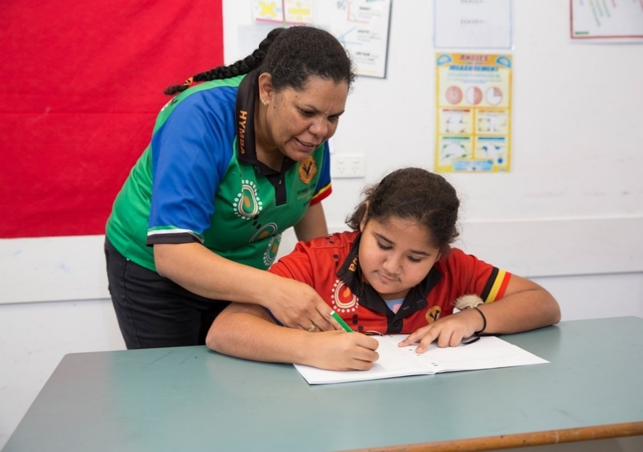
ABSTUDY and orientation activities
ABSTUDY can help with travelling to schools before you enrol
This allows you to see where your child will live while at school
ABSTUDY can pay for travel, accommodation and meals
Claim ABSTUDY before you travel.
Notes:
If you’re thinking about enrolling your child in a school away from home, ABSTUDY can help.
Visiting school before you enrol your child can help them to settle in.
Schools will let you know when they’re holding an orientation day. Orientation activities include:
Open days
Interviews/assessment
Transition programs
Orientation days
ABSTUDY can pay for you and your child to travel to the school and stay for a visit. This might be to visit a boarding school, boarding house or hostel.
This gives you a chance to see where your child will live, meet the teachers and staff and ask any questions you might have.
ABSTUDY can pay for you and your child to visit more than one school
You need to claim ABSTUDY and wait until your claim is approved before you travel
Once you’ve let the school know you want to come to their open day, they’ll work with ABSTUDY to book travel for you and your child.

Slide 8

How to claim ABSTUDY
      Phone us by calling ABSTUDY 1800 132 317
      Claim from October in the year before your child starts high school
      We’ll help you work out which payment is best for your child.
Watch on YouTube
https://www.youtube.com/watch?v=Etevhl-rkEg&list=PL3zxsbzVCpwnjn8TfIP43LFdpiRtpkLwD&index=2
Notes:
[OPTION TO PLAY VIDEO OR READ FROM NOTES] – The video talks about what parents need to do to claim ABSTUDY for their child.
If you’re claiming ABSTUDY for your child make sure you do it before they start high school or before they attend orientation activities.
You don’t need to know which payments your child is eligible for before you call ABSTUDY, they can help you work this out!
You’ll need to have some information ready for when you call. This includes details about school, living arrangements and why your child may need to study away from home.
If your child is 15 or under you can claim ABSTUDY for them. If they’re 16 or over, they can claim themselves. Your child will need to have their own Tax File Number once they turn 16.
You can give your child's future school permission to enquire about their ABSTUDY. You do this over the phone with ABSTUDY or by filling out a form. Having permission to enquire will let your child's school ask us about your child's ABSTUDY payments and eligibility. It can also help with planning travel.

Slide 9
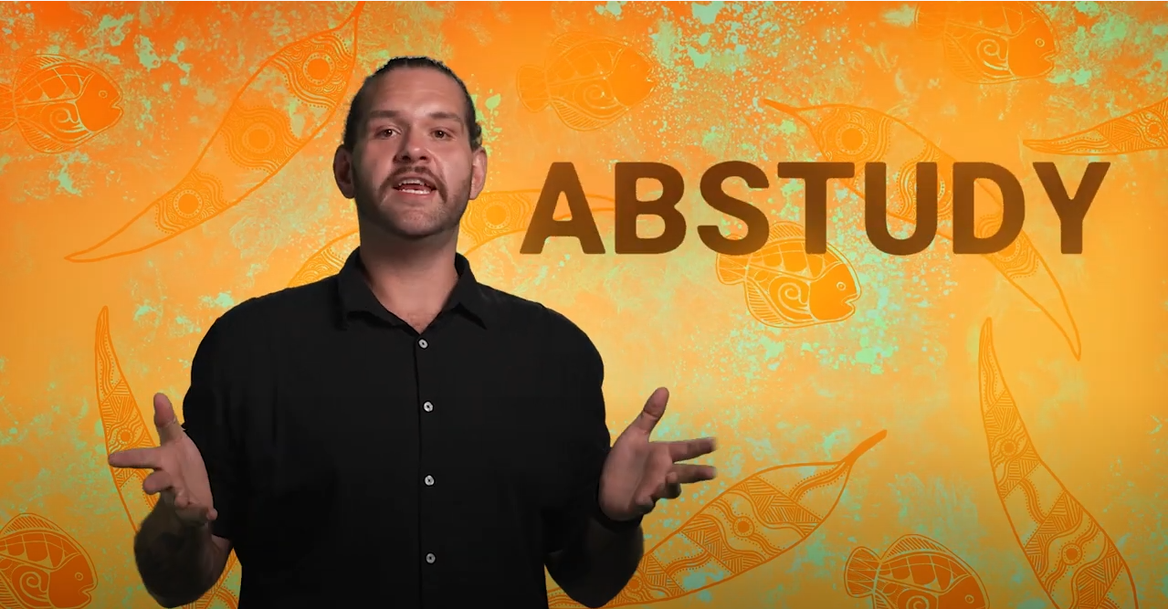
Tips
Let us know about any changes so you don’t get overpaid and have to pay back a debt!
Changes could include your child moving back home or starting to live with someone else.
Get your child a Tax File Number from the Australian Taxation Office (ATO)
If they don’t have one when they turn 16, their ABSTUDY payment will stop!
Watch on YouTube
https://www.youtube.com/watch?v=dwn9nqmCJso
Notes:
[OPTION TO PLAY VIDEO OR READ FROM NOTES] – The video talks about tips to make sure you’re getting the most out of ABSTUDY payments.
If anything changes while your child gets ABSTUDY, you need to let Services Australia know within 14 days. Make sure you do this or you may end up with a debt.
This could be:
your child moves back home
they change schools
your income or your partner’s income changes
you move house
your child’s primary carer changes.
If your child is 16 or older, they need a tax file number to get ABSTUDY. If they don’t have one when they turn 16 their ABSTUDY payment will stop.
They can get their own tax file number from age 13. If they’re younger you’ll have to sign a form for them.

Slide 10
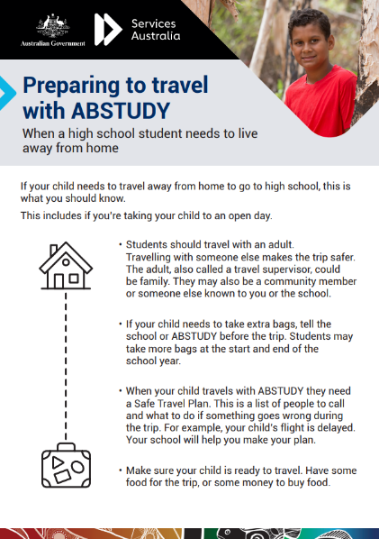
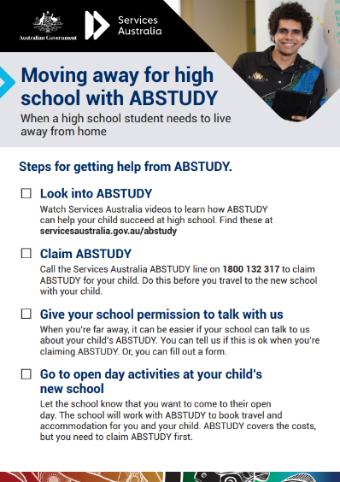
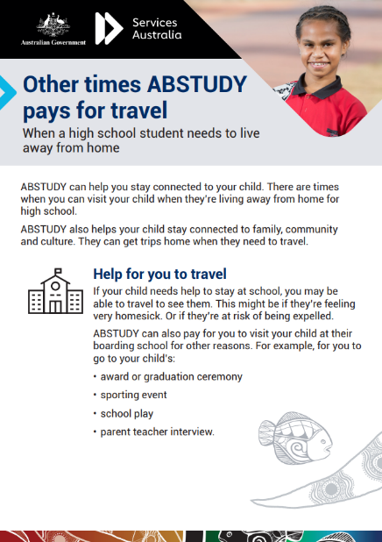



Resources
Services Australia website
servicesaustralia.gov.au/abstudy
Download our eKits
servicesaustralia.gov.au/abstudyresources
Get reminders and ask questions on social media
/ServicesAustralia
Services.Australia
@ServicesAustraliaGovAu
Notes:
There are a lot of resources available if you want to know more about ABSTUDY.
You can read about ABSTUDY on the Services Australia website.
You can watch the ABSTUDY videos on YouTube.
You can ask questions from staff through the Services Australia Facebook or Instagram page.
You can also download factsheets and posters from the ABSTUDY resource kits on the Service Australia website.

Slide 11

Find out more about ABSTUDY
Call ABSTUDY on 1800 132 317
servicesaustralia.gov.au/abstudy
Notes:
Call the ABSTUDY line with any questions you might have on 1800 132 317. This can be if you’re wanting to claim a payment for your child or your child is getting a payment and something is wrong. You can contact ABSTUDY from Monday to Friday 8am to 5pm.

Slide 12
servicesaustralia.gov.au/abstudy

